Slide 1
A Project Presentation on
Automatic Water Vending Machine
(A dissertation submitted in partial fulfilment of the requirements of Bachelor of Technology in
Electronics & Communication Engineering of the Maulana Abul Kalam Azad University of
Technology, West Bengal)
Academic Year: 2019-2023
Submitted by
Chitradeep Sinha [Roll No: 19101105008]
Santu Roy [Roll No: 19101105050]
Ajoy Naskar [Roll No: 19101105048]
Santu Sardar [Roll No: 19101105043]
Kuddus Sk. [Roll No: 19101105005]
Under the guidance of
Dr. Swagata Mondal
Assistant Professor
Department of Electronics & Communication Engineering

Slide 2
Introduction
Now a day’s water vending machines are available and operated on only cash but our aim is to design water vending machine which has a feature to provide cashless transaction through UPI. In India there is problem of safe drinking water therefore we are going to provide mineral water. Water has become the most commercial products of the century. This may sound bizarre, but true. The stress on the multiple water resources is a result of a multitude of factors. On the one hand, the rapidly rising population and changing lifestyles have increased the need for fresh water. If opportunity costs were taken into account, it would be clear that in most rural areas, households are paying far more for water supply than the often-normal rates charged in urban areas. Also, if this cost of fetching water which is almost equivalent to 150 million women days each year, is covered into a loss for the national exchequer, it translates into a whopping 10 billion rupees per year. In summer we face the problem of drinking water. So is the panic over drinking water supply in the city as well as in villages. The reservoir has just 35.63 feet of water, which is not even half of the total water level. With the present arrangement of reduced frequency of water supply. Meanwhile, other sources of water such as tanks have dried up. As the problem of water shortage has been increasing by the day, slum-dwellers are being forced to fetch water from other sources located at a distance from their houses. There have been reports of quarrels between slum-dwellers over fetching water from public taps. Our project aims at fulfilling the needs of different quality of water at a very subsidised rate

Slide 3
Hardware Implementation
A water filling system controlled by Arduino is a type of automatic water filling system that uses an Arduino microcontroller to control the various components of the system. The Arduino can be used to control a pump, valves, and sensors to regulate the flow of water and to start and stop the filling process. The Arduino can be programmed using the Arduino IDE, which supports C and C++ programming languages and has a simple and user-friendly interface. There are also several libraries available for the Arduino that can be used to control the pump and valves, as well as to read sensor data and provide feedback to the user. In this project, we will design and build a prototype automatic bottle filling machine using the Arduino board. The Arduino board performs all control functions. The desired amount of liquid to be filled is first given by the user via the 4×4 matrix keypad. Water is drawn from the tank by the water pump and passes through the liquid flow sensor which allows the water flow value to be sent to the Arduino board. Finally, the relay cuts off the connection of the water pump when the liquid that has passed through the yf-s401 sensor is almost equal to the amount given by the user.

Slide 4
Hardware Components
Arduino UNO: The Arduino UNO is a microcontroller board based on the ATmega328P. It is a popular choice for beginners and hobbyists as it is easy to use and has a wide range of available libraries and tutorials. The board has 14 digital input/output pins (of which 6 can be used as PWM outputs), 6 analog inputs, a 16 MHz quartz crystal, a USB connection, a power jack, an ICSP header, and a reset button. It can be programmed using the Arduino IDE, which supports C and C++ programming languages and has a simple and user-friendly interface. The board can be powered via USB or an external power source, and can be used to control and interface with various electronic devices and sensors.
YF-S401 Sensor: The YF-S401 sensor is a type of water flow sensor that can be used to measure the flow rate and volume of fluid flowing through a pipe. It can be used in various applications such as irrigation systems, water treatment plants, and industrial process control. The YF-S401 sensor is typically used in conjunction with an Arduino microcontroller to read and process the sensor data. To use the YF-S401 sensor with an Arduino, you will need to connect the sensor to the Arduino’s digital input pins. The sensor has three pins: GND, VCC, and Signal. GND should be connected to GND of the Arduino, VCC to 5V, and Signal to a digital pin. Once the connections are made, you can use the Arduino to read the sensor’s output signal and calculate the flow rate and volume of fluid flowing through the pipe.

Slide 5
Hardware Components
3. 12V Water Pump: A water pump that operates at 12V is a type of pump that is designed to run on a 12-volt DC power supply. These types of pumps are commonly used in automotive, marine, and RV applications, as well as in small scale irrigation, water treatment and other similar systems. One of the advantages of using a 12V water pump is that it can be powered by a car battery or a deep-cycle battery, which makes it portable and convenient for use in remote locations. The use of a 12V water pump with an Arduino microcontroller requires an external power source, as the Arduino can’t provide the needed power to operate the pump.
4. Relay: A relay is an electronic switch that can be controlled by an Arduino microcontroller to turn a water pump on and off. When the relay is energized, it closes an electrical circuit, allowing electricity to flow through the pump and turn it on. When the relay is de-energized, it opens the circuit, cutting off the electricity and turning the pump off. To use a relay to control a water pump with an Arduino, you will need to connect the relay to the Arduino‘s digital output pins. The relay typically has three pins, VCC, GND, and IN. VCC should be connected to 5V of the Arduino, GND to GND, and IN to a digital pin of the Arduino. Once the connections are made, you can use the Arduino‘s digitalWrite function to turn the relay on and off, and thus control the water pump.

Slide 6
Hardware Components
5. 4×4 Keypad: A 4×4 keypad is a type of input device that consists of 16 buttons arranged in a 4×4 grid. It can be used to provide a convenient way for a user to input data or commands into an Arduino-controlled system. To connect a 4×4 keypad to an Arduino, you will need to connect the keypad’s rows and columns to the Arduino‘s digital input/output pins. The keypad typically has eight pins, four for the rows and four for the columns. The rows are connected to the Arduino‘s digital output pins and the columns are connected to the Arduino’s digital input pins. Once the connections are made, you can use the Arduino to read the state of the keypad’s buttons by scanning the columns and reading the state of the rows. The Arduino can then determine which button is pressed by using a combination of the row and column states. There are libraries available for the Arduino that make it easy to read a 4×4 keypad, such as the Keypad library, which can be used to initialize the keypad and read the state of the buttons

Slide 7
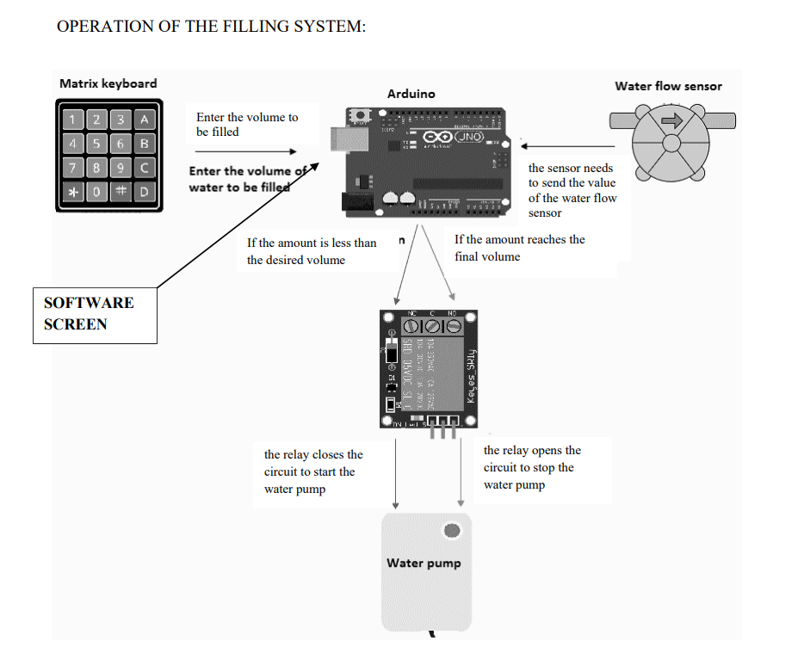

Slide 8
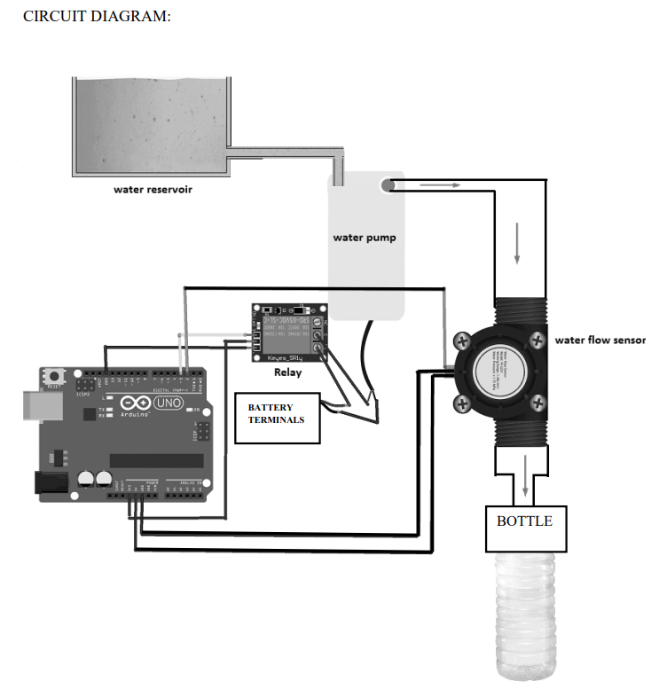

Slide 9
Software Implementation
Introduction: The Water ATM Software Implementation Project aims to develop and implement a software system for managing and operating Water ATMs. The project focuses on providing a reliable and efficient solution for monitoring tracking, transactions and hardware-software integration in a efficient way. This report provides an overview of the project, its objectives, methodologies, and outcomes.
Objectives: The main objectives of the Water ATM Software Implementation Project are as follows:
Develop a user-friendly software system for managing Water ATMs.
Monitor and maintain water quantity standards in real-time.
Enable secure and efficient transactions for water dispensing.

Slide 10
Software Implementation
Methodologies: The project followed the following methodologies for successful implementation:
Requirement Gathering: Conducted meetings with group members to gather software requirements and understand their needs to complete the software part.
System Design: Developed a software architecture and design based on the gathered requirements.
Development: Implemented the software system using appropriate programming languages (html, css, js) and database (MongoDB).
Testing: Conducted thorough testing to ensure the software's functionality, reliability, and security.
Deployment: Deployed the software system on the Water ATMs.
Training and Documentation: Provided training sessions for users and prepared comprehensive documentation for future reference.

Slide 11
Software Implementation
Software features:
User Registration and Authentication: Allow users to create accounts through email id.
Water Quantity Monitoring: Integrate sensors to continuously monitor water quantity. Provide real-time data and alerts for any deviations from the desired standards.
Transaction Management: Enable secure and convenient transactions for dispensing water. Users should be able to select the desired quantity of water, make payments through user-friendly UPI method, and receive a confirmation through mail.
User Support and Feedback: Provide a mechanism for users to provide feedback, report issues, or seek assistance. Support channels may include a helpline, email support, or an in-app messaging system.

Slide 12
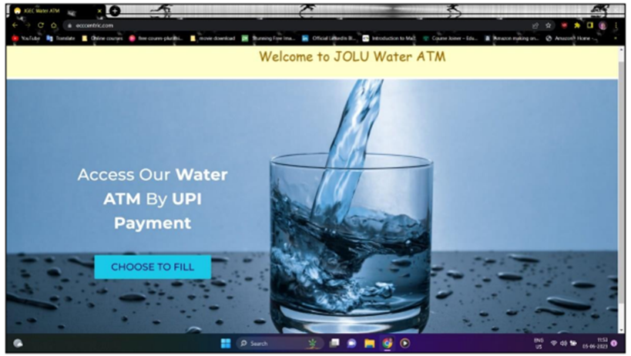
Home Screen

Slide 13
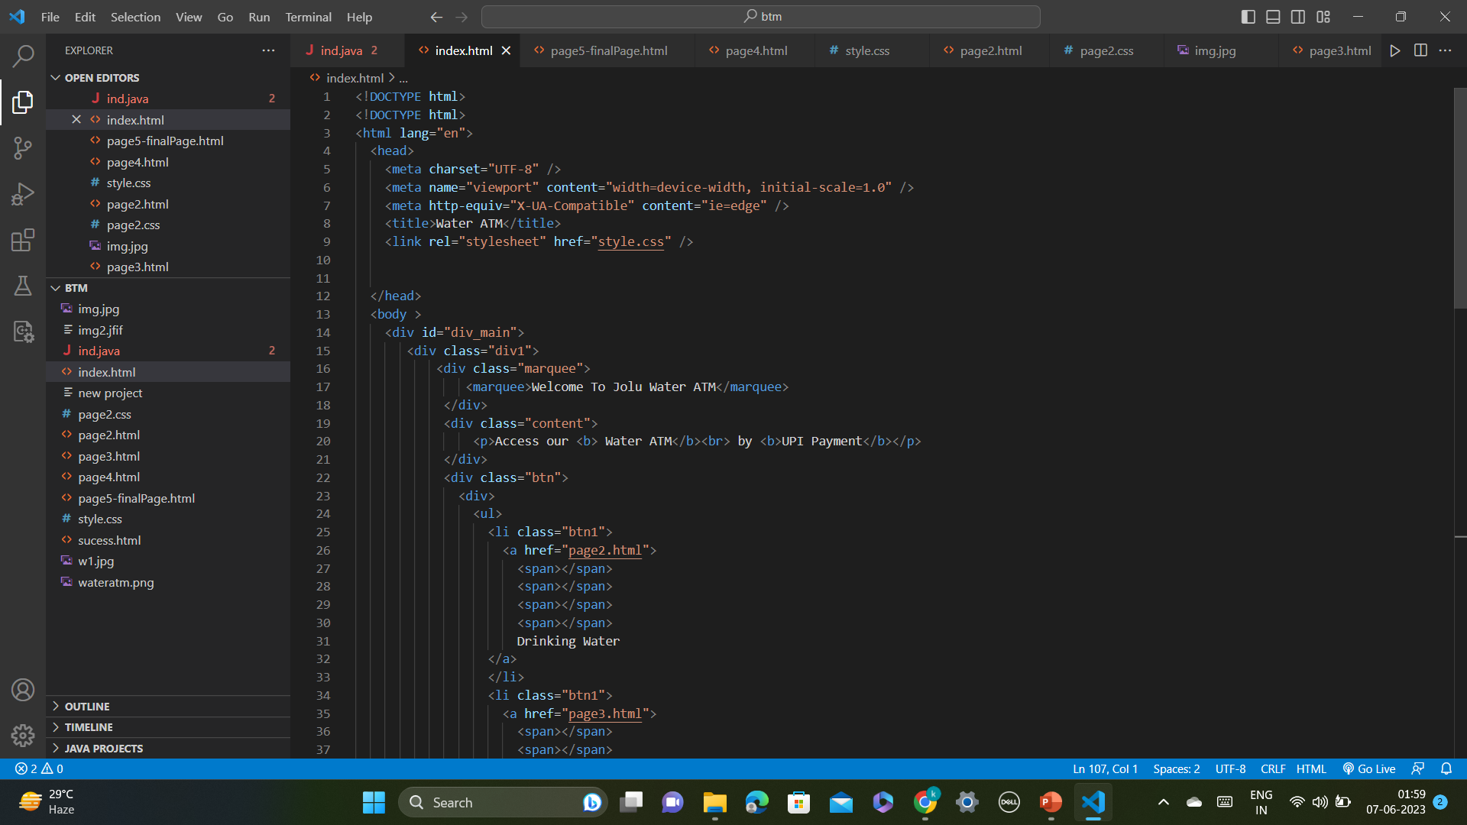
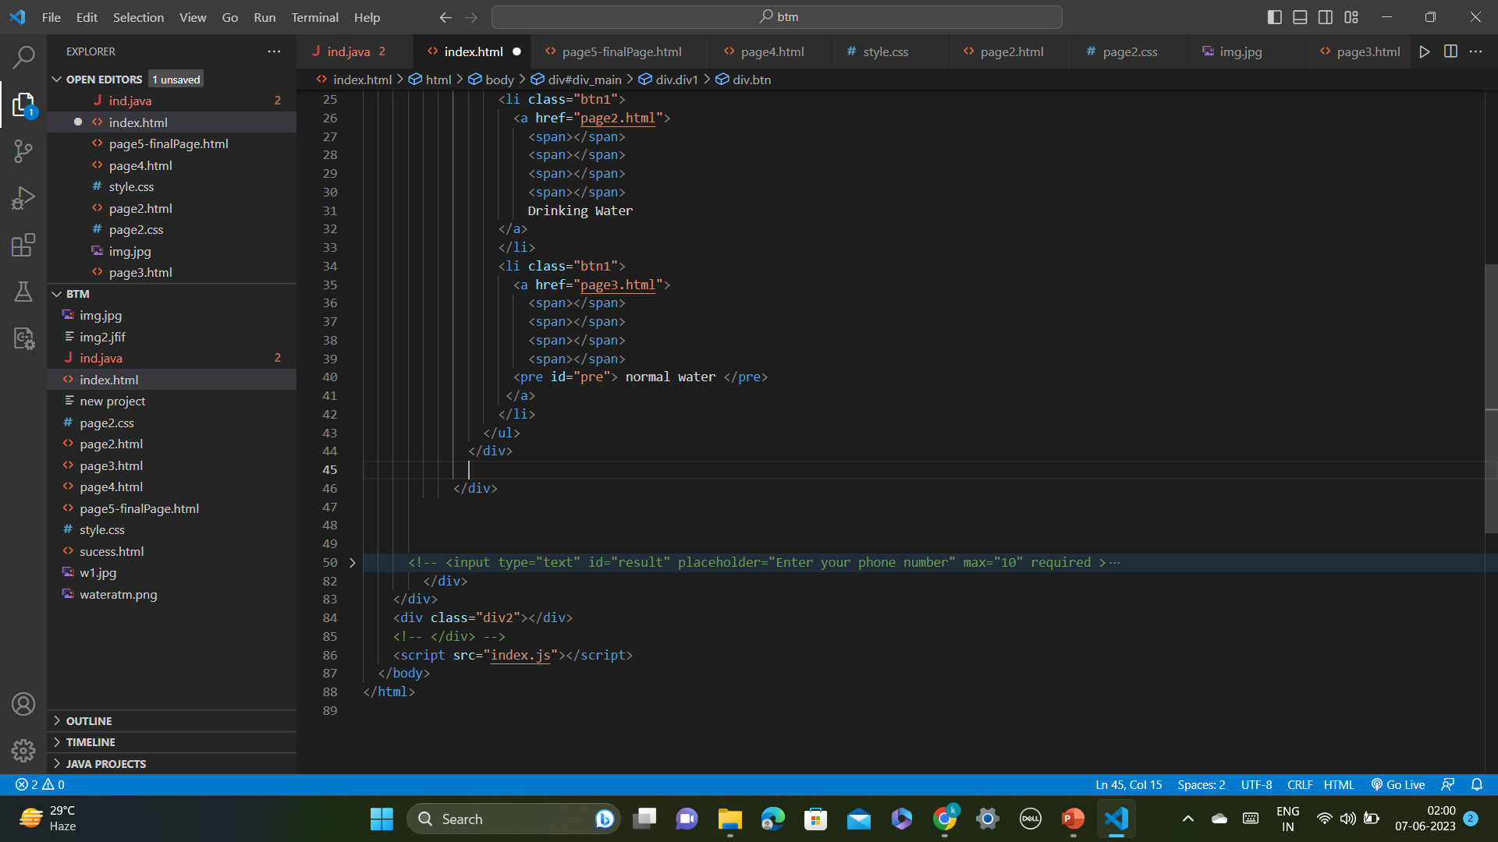
Code for Homescreen

Slide 14
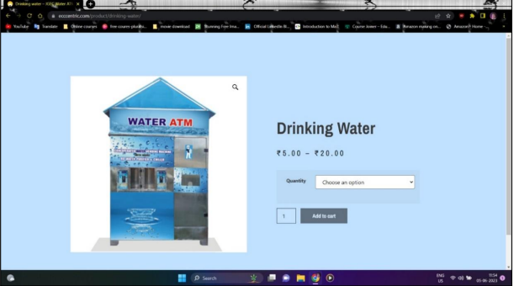
Payment Page

Slide 15
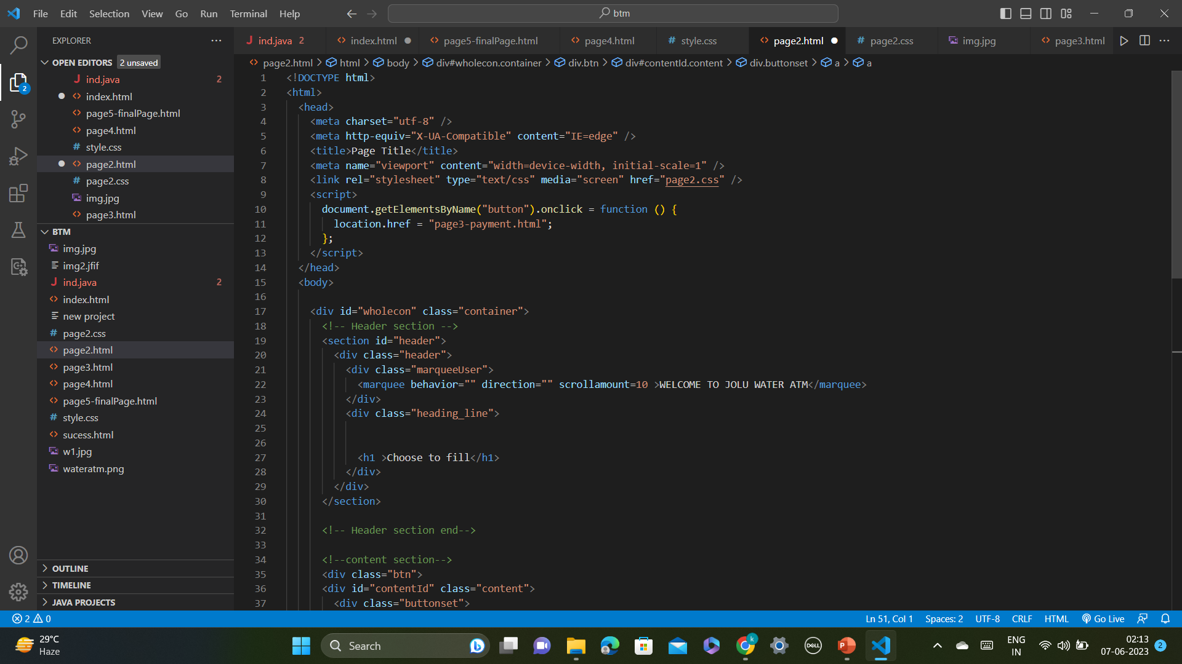
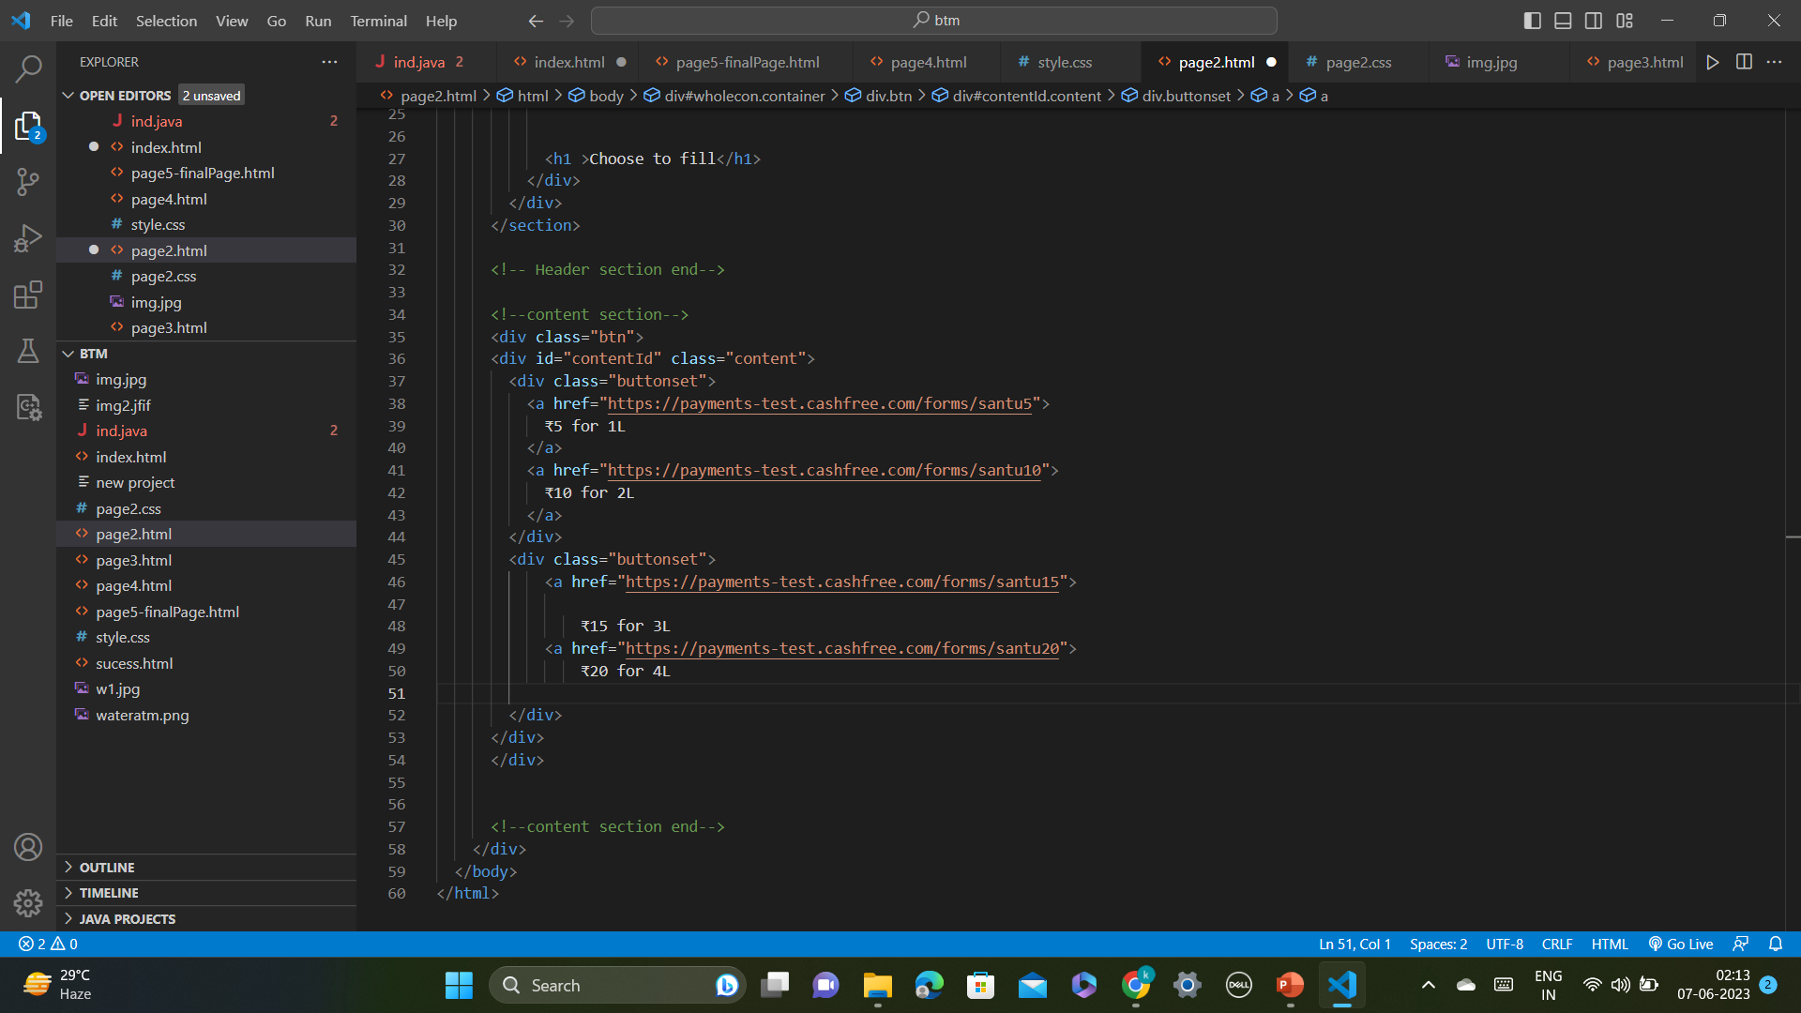
Code for Payment page

Slide 16
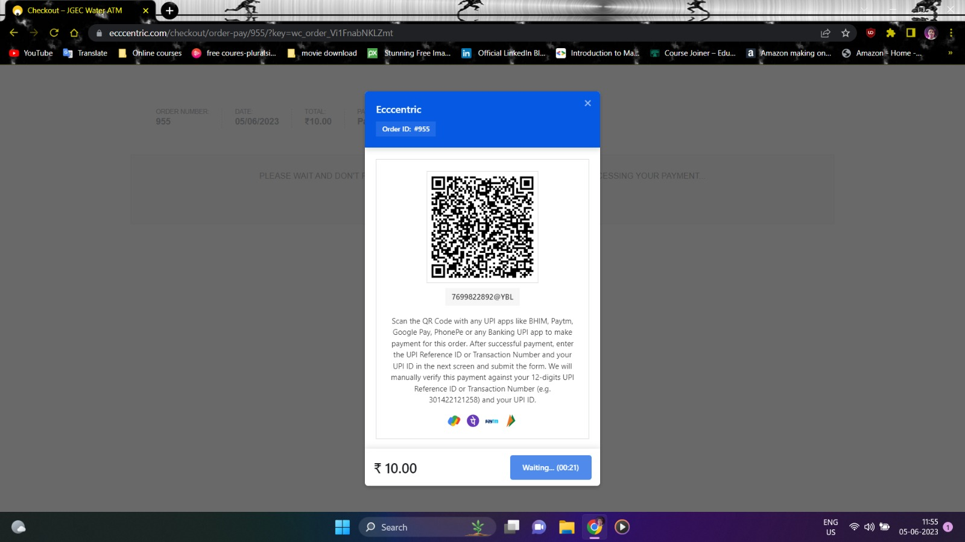
QR Code Scanner

Slide 17
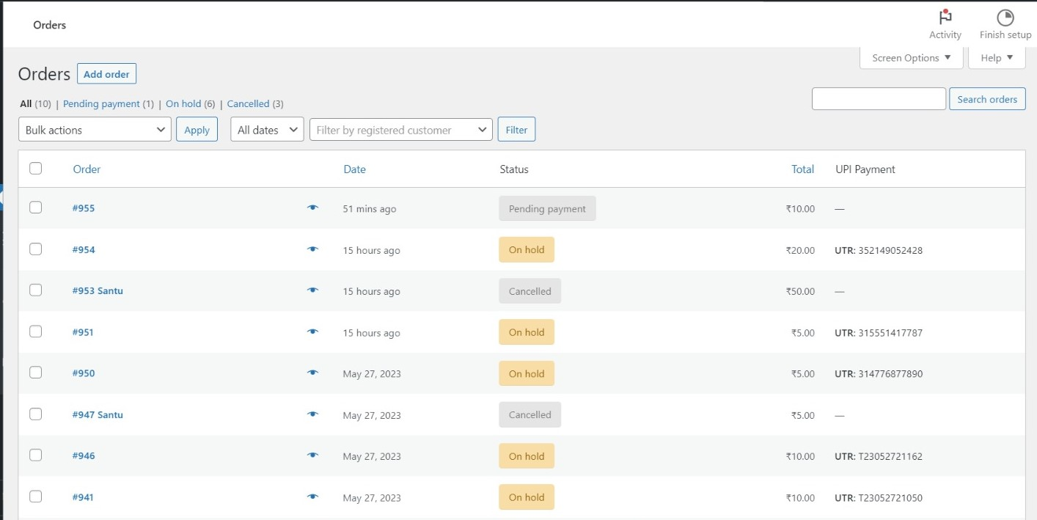
Database

Slide 18
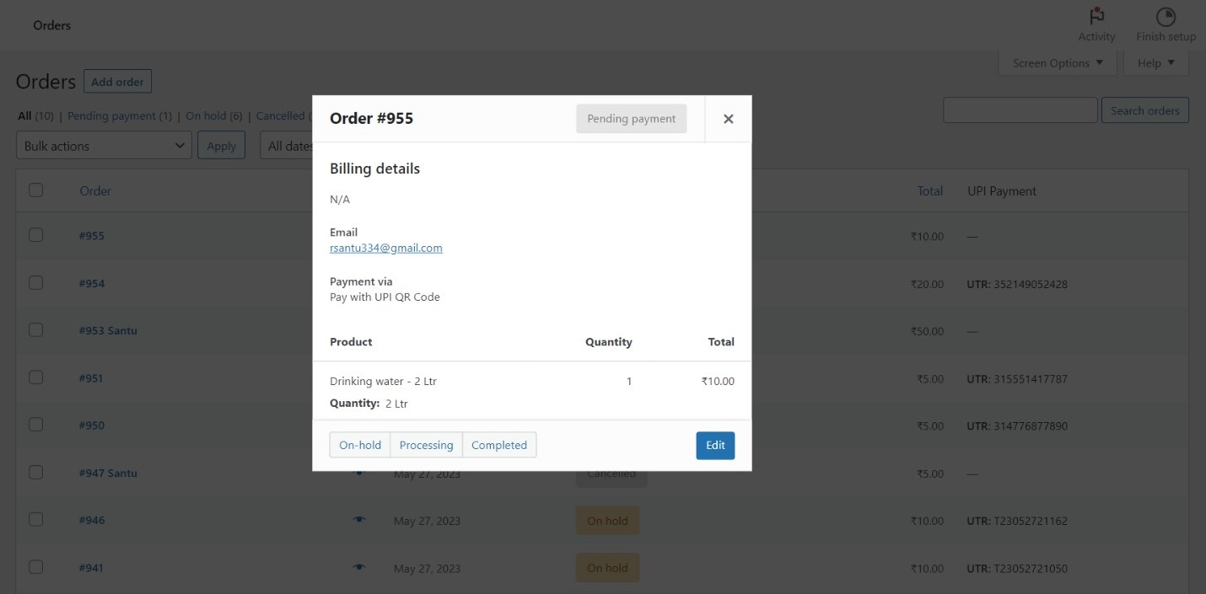
Billing Details

Slide 19
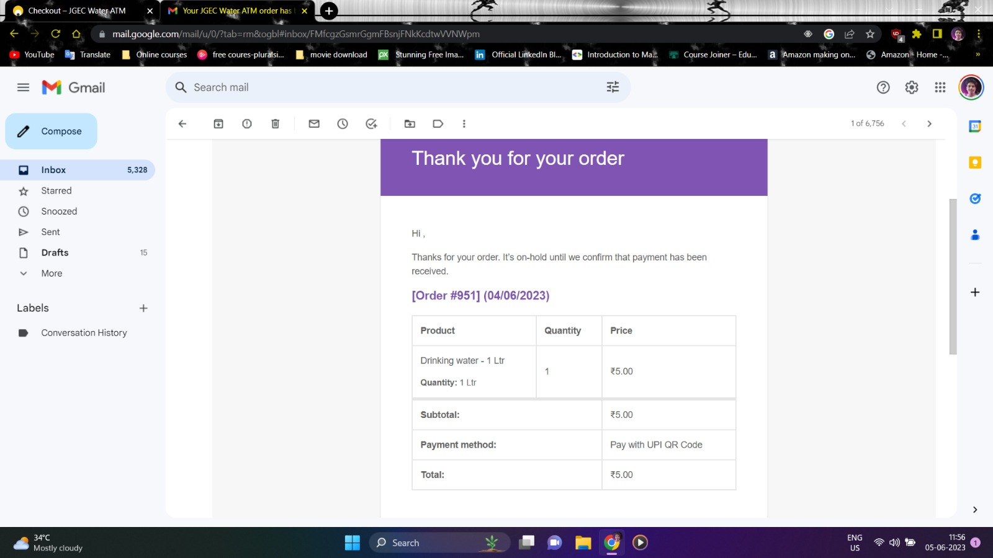
Payment Confirmation

Slide 20
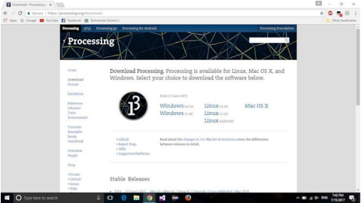
Hardware - Software Integration
We've actually used the Serial communications capability already quite a bit...that's how we send sketches to the Arduino! When you Compile/Verify what you're really doing is turning the sketch into binary data (ones and zeros). When you Upload it to the Arduino, the bits are shoved out one at a time through the USB cable to the Arduino where they are stored in the main chip. Next time you upload a sketch, the two LEDs near the USB connector, they'll blink when data is being transmitted. One blinks when the Arduino is receiving data (RX) and one blinks when the Arduino is transmitting data (TX) For the Software GUI making we have used the Processing IDE.

Slide 21
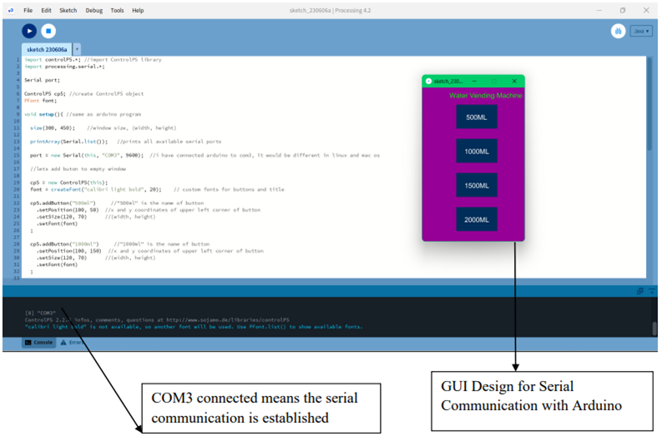

Slide 22
A basic GUI is designed to send the values to the Serial port through the software. The connections with the hardware remain unchanged and only the USB Port is connected with a cable. The link for the software is provided below:
[ https://drive.google.com/drive/folders/1uNSgiMhNeigwzC73xpfFv2k8TX39AbH-?usp=sharing ]

Slide 23
Conclusion
It is equipped with interactive user interface system that eliminates the uses of push buttons. In conclusion, the project has achieved all the proposed objectives to improve the overall performance of the vending machine on terms of cost saving, attractiveness, reliability, and not easily damaged by vandalism activities. The model of the vending machine successfully detects the payment made through UPI and dispenses liquid output. It is also proved to be customer friendly. The system developed in this research work can be used as a base for future development.

